Slide 1
ECEG-5193: Algorithm Analysis and Design
Analysis of Sorting and Searching algorithms
Analysis of Simple Algorithms

Slide 2
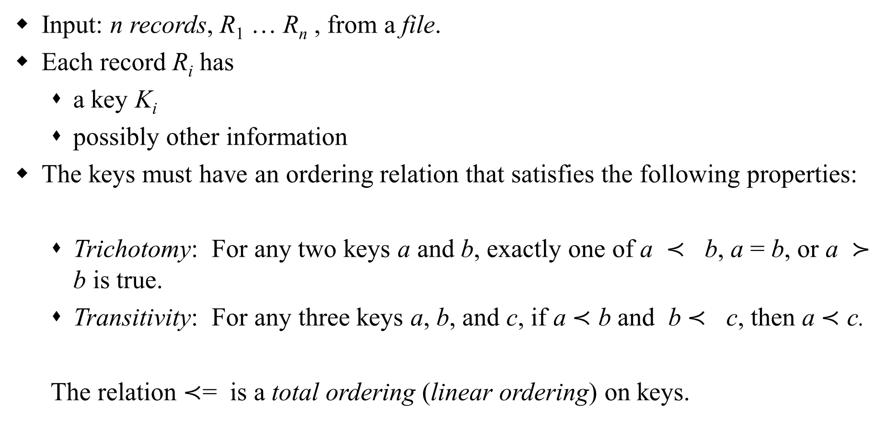
Sorting – Definitions
Input: n records, R₁ … R_{n} , from a file.
Each record R_{i} has
a key K_{i}
possibly other information
The keys must have an ordering relation that satisfies the following properties:
Trichotomy: For any two keys a and b, exactly one of a $≺$ b, a = b, or a $≻$ b is true.
Transitivity: For any three keys a, b, and c, if a $≺$ b and b $≺$ c, then a $≺$ c.
The relation $≺$= is a total ordering (linear ordering) on keys.
Notes:
Precedes succeeds

Slide 3
Sorting – Definitions
Sorting: determine a permutation Π = (p₁, … , p_{n}) of n records that puts the keys in non-decreasing order Kp₁ < … < Kp_{n}.
Permutation: a one-to-one function from
{1, …, n} onto itself. There are n! distinct permutations of n items.
Rank: Given a collection of n keys, the rank of a key is the number of keys that precede it. That is, rank(K_{j}) = |{K_{i}| K_{i} < K_{j}}|. If the keys are distinct, then the rank of a key gives its position in the output file.

Slide 4
Sorting Terminology
Internal (the file is stored in main memory and can be randomly accessed) vs. External (the file is stored in secondary memory & can be accessed sequentially only)
Comparison-based sort: uses only the relation among keys, not any special property of the representation of the keys themselves.
Stable sort: records with equal keys retain their original relative order; i.e., i < j & Kp_{i} = Kp_{j} ⇒ p_{i} < p_{j}
Array-based (consecutive keys are stored in consecutive memory locations) vs. List-based sort (may be stored in nonconsecutive locations in a linked manner)
In-place sort: needs only a constant amount of extra space in addition to that needed to store keys.

Slide 5
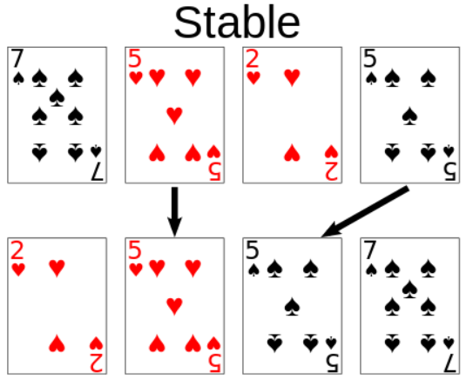
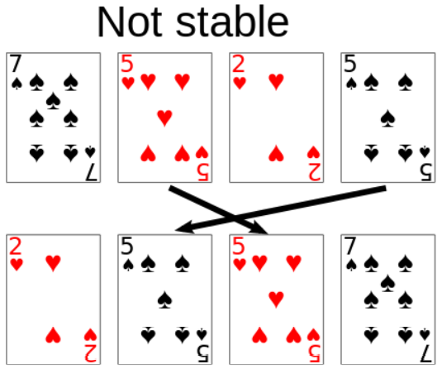
Stable Sort

Slide 6
Sorting Categories
Sorting by Insertion insertion sort, shellsort
Sorting by Exchange bubble sort, quicksort
Sorting by Selection selection sort, heapsort
Sorting by Merging merge sort
Sorting by Distribution radix sort

Slide 7
Sorting Algorithms
Internal sort
Collection of data fits in memory
External sort
Collection of data does not all fit in memory
Must reside on secondary storage

Slide 8
Elementary Sorting Methods
Easier to understand the basic mechanisms of sorting.
Good for small files.
Good for well-structured files that are relatively easy to sort, such as those almost sorted.
Can be used to improve efficiency of more powerful methods.

Slide 9
Elementary Sorting Algorithms
The Selection Sort
The Bubble Sort
The Insertion Sort

Slide 10
Selection Sort
Selection-Sort(A, n)
1. for i = n downto 2 do
2. max ← i
3. for j = i – 1 downto 1 do
4. if A[max] < A[j] then
5. max ← j
6. t ← A[max]
7. A[max] ← A[i]
8. A[i] ← t

Slide 11





The Selection Sort
29 | 10 | 14 | 37 | 13
Gray elements are selected
Blue elements comprise the sorted portion of the array

Slide 12
Selection Sort
i
63 | 25 | 12 | 22 | 11
void selectionSort(int[] a)
{ for (int i = 0; i < a.length - 1; i++)
{ int min = i; for (int j = i + 1; j < a.length; j++)
{ if (a[j] < a[min])
{ min = j; } } if (i != min)
{ int swap = a[i]; a[i] = a[min]; a[min] = swap; } } }
i
min
63 | 25 | 12 | 22 | 11
i
min
11 | 25 | 12 | 22 | 63
i
min
11 | 12 | 25 | 22 | 63
i, min
11 | 12 | 22 | 25 | 63
i, min
11 | 12 | 22 | 25 | 63

Slide 13
Selection Sort: Algorithm Analysis
The number of comparisons is Θ(n²) in all cases.
Can be improved by a some modifications, which leads to heapsort.

Slide 14
The Selection Sort
Analysis
Selection sort is O(n²)
Appropriate only for small n,
O(n²) grows rapidly
Could be a good choice when
Data moves are costly,
But comparisons are not

Slide 15
The Bubble Sort
Compares adjacent items
Exchanges them if out of order
Requires several passes over the data
When ordering successive pairs
Largest item bubbles to end of the array

Slide 16
Bubble Sort: Example
5 | 1 | 4 | 2 | 8
5 | 1 | 4 | 2 | 8
1 | 5 | 4 | 2 | 8
for (i = n-1 ; i > 0 ; i--)
for (j = 0; j < i ; j++)
if (a[j] < a[j+1])
swap a[j] and a[j+1]
1 | 5 | 4 | 2 | 8
1 | 4 | 5 | 2 | 8
1 | 4 | 5 | 2 | 8
1 | 4 | 2 | 5 | 8
1 | 4 | 2 | 5 | 8
1 | 4 | 2 | 5 | 8
1 | 4 | 2 | 5 | 8
1 | 4 | 2 | 5 | 8
1 | 4 | 2 | 5 | 8
1 | 2 | 4 | 5 | 8
1 | 2 | 4 | 5 | 8
1 | 2 | 4 | 5 | 8
1 | 2 | 4 | 5 | 8
1 | 2 | 4 | 5 | 8
1 | 2 | 4 | 5 | 8
1 | 2 | 4 | 5 | 8
1 | 2 | 4 | 5 | 8
1 | 2 | 4 | 5 | 8

Slide 17
The Bubble Sort
Analysis
Worst case O(n²)
Best case (array already in order) is O(n)

Slide 18
Insertion Sort
InsertionSort(A, n)
1. for j = 2 to n do
2. key ← A[j]
3. i ← j – 1
4. while i > 0 and key < A[i]
5. A[i+1] ← A[i]
6. i ← i – 1
7. A[i+1] ← key

Slide 19
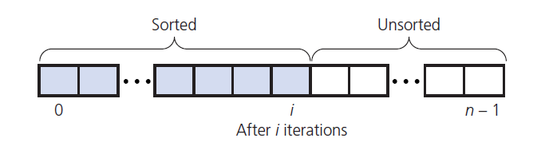
The Insertion Sort
Take each item from unsorted region
Insert it into correct order in sorted region

Slide 20
Insertion Sort
InsertionSort(array A) begin for i := 1 to length[A] - 1 do begin value := A[ i ]; j := i - 1; while j >= 0 and A[ j ] > value do begin A[ j + 1] := A[ j ]; j := j - 1; end; A[ j + 1] := value; end; end;
63 | 25 | 12 | 22 | 11
63 | 25 | 12 | 22 | 11
25 | 63 | 12 | 22 | 11
25 | 63 | 12 | 22 | 11
12 | 25 | 63 | 22 | 11
12 | 25 | 63 | 22 | 11
12 | 22 | 25 | 63 | 11
12 | 22 | 25 | 63 | 11
11 | 12 | 22 | 25 | 63

Slide 21
The Insertion Sort
Analysis
Worst case O(n²)
Best case (array already in order) is O(n)
Appropriate for small (n < 25) arrays
Unsuitable for large arrays
Unless already sorted

Slide 22
The Insertion Sort: Algorithm Analysis
No. of Comparisons:
If A is sorted: Θ(n) comparisons
If A is reverse sorted: Θ(n²) comparisons
If A is randomly permuted: Θ(n²) comparisons

Slide 23
The Insertion Sort: Worst-case Analysis
The maximum number of comparisons while inserting A[i] is (i-1). So, the number of comparisons is
C_{wc}(n) ≤ ∑_{i = 2 to n} (i -1)
= ∑_{j = 1 to n-1} j
= n(n-1)/2
= Θ(n²)
For which input does insertion sort perform n(n-1)/2 comparisons?

Slide 24
The Insertion Sort: Average-case Analysis
Want to determine the average number of comparisons taken over all possible inputs.
Determine the average no. of comparisons for a key A[j].
A[j] can belong to any of the j locations, 1..j, with equal probability.
The number of key comparisons for A[j] is j–k+1, if A[j] belongs to location k, 1 < k ≤ j and is j–1 if it belongs to location 1.
Average no. of comparisons for inserting key A[j] is:
Notes:
If it’s in slot 1 or slot 2, it still has to do i-1 comparisons.

Slide 25
The Insertion Sort: Average-case Analysis
Summing over the no. of comparisons for all keys,
Therefore, T_{avg}(n) = Θ(n²)

Slide 26
Analysis of Inversions in Permutations
Inversion: A pair (i, j) is called an inversion of a permutation Π if i < j and Π(i) > Π(j).
Worst Case: n(n-1)/2 inversions. For what permutation?
Average Case:
Let Π^{T} = {Π₁, Π₂, …, Π_{n} } be the transpose of Π.
Consider the pair (i, j) with i < j, there are n(n-1)/2 pairs.
(i, j) is an inversion of Π if and only if (n-j+1, n-i+1) is not an inversion of Π^{T}.
This implies that the pair (Π, Π^{T}) together have n(n-1)/2 inversions.
⇒ The average number of inversions is n(n-1)/4.

Slide 27
Theorem
Theorem: Any algorithm that sorts by comparison of keys and removes at most one inversion after each comparison must do at least n(n-1)/2 comparisons in the worst case and at least n(n-1)/4 comparisons on the average.
So, if we want to do better than Θ(n²) , we have to remove more than a constant number of inversions with each comparison.

Slide 28
Shellsort
Simple extension of insertion sort.
Gains speed by allowing exchanges with elements that are far apart (thereby fixing multiple inversions).
h-sort the file
Divide the file into h subsequences.
Each subsequence consists of keys that are h locations apart in the input file.
Sort each h-sequence using insertion sort.
Will result in h h-sorted files. Taking every hth key from anywhere results in a sorted sequence.
h-sort the file for decreasing values of increment h, with h=1 in the last iteration.
h-sorting for large values of h in earlier iterations, reduces the number of comparisons for smaller values of h in later iterations.
Correctness follows from the fact that the last step is plain insertion sort.

Slide 29
Shellsort
A family of algorithms, characterized by the sequence {h_{k}} of increments that are used in sorting.
By interleaving, we can fix multiple inversions with each comparison, so that later passes see files that are “nearly sorted.” This implies that either there are many keys not too far from their final position, or only a small number of keys are far off.

Slide 30
Shellsort
ShellSort(A, n)
1. h ← 1
2. while h ≤ n {
3. h ← 3h + 1
4. }
5. repeat
6. h ← h/3
7. for i = h to n do {
8. key ← A[i]
9. j ← i
10. while key < A[j - h] {
11. A[j] ← A[j - h]
12. j ← j - h
13. if j < h then break
14. }
15. A[j] ← key
16. }
17. until h ≤ 1
When h=1, this is insertion sort.
Otherwise, performs insertion sort on keys h locations apart.
h values are set in the outermost repeat loop. Note that they are decreasing and the final value is 1.

Slide 31
Algorithm Analysis
In-place sort
Not stable
The exact behavior of the algorithm depends on the sequence of increments -- difficult & complex to analyze the algorithm.
For h_{k} = 2^{k} - 1, T(n) = Θ(n^{3/2} )

Slide 32
Summary
Name | Best | Average | Worst | Stable
Insertion Sort | n | n² | n² | Yes
Selection Sort | n² | n² | n² | No
Bubble Sort | n | n² | n² | Yes
Shell Sort | n log n | n^{4/3} | n^{3/2} | No

Slide 33
Proving Correctness
Name | Best | Average | Worst | Stable
Insertion Sort | n | n² | n² | Yes
Selection Sort | n² | n² | n² | No
Bubble Sort | n | n² | n² | Yes
Shell Sort | n log n | n^{4/3} | n^{3/2} | No

Slide 34
Insertion sort
Does this actually work? Let’s see an example!
def insertion_sort(A):
for i in range(1, len(A)):
cur_value = A[i]
j = i - 1
while j >= 0 and A[j] > cur_value:
A[j+1] = A[j]
j -= 1
A[j+1] = cur_value
4
3
1
5
2

Slide 35
Insertion sort
Does this actually work? Let’s see an example!
def insertion_sort(A):
for i in range(1, len(A)):
cur_value = A[i]
j = i - 1
while j >= 0 and A[j] > cur_value:
A[j+1] = A[j]
j -= 1
A[j+1] = cur_value
4
3
1
5
2
Move A[1] leftwards until you find something smaller (or can’t go move it any further).

Slide 36
Insertion sort
Does this actually work? Let’s see an example!
def insertion_sort(A):
for i in range(1, len(A)):
cur_value = A[i]
j = i - 1
while j >= 0 and A[j] > cur_value:
A[j+1] = A[j]
j -= 1
A[j+1] = cur_value
3
4
1
5
2

Slide 37
Insertion sort
Does this actually work? Let’s see an example!
def insertion_sort(A):
for i in range(1, len(A)):
cur_value = A[i]
j = i - 1
while j >= 0 and A[j] > cur_value:
A[j+1] = A[j]
j -= 1
A[j+1] = cur_value
3
4
1
5
2

Slide 38
Insertion sort
Does this actually work? Let’s see an example!
def insertion_sort(A):
for i in range(1, len(A)):
cur_value = A[i]
j = i - 1
while j >= 0 and A[j] > cur_value:
A[j+1] = A[j]
j -= 1
A[j+1] = cur_value
3
4
1
5
2
Do the same thing for A[2].

Slide 39
Insertion sort
Does this actually work? Let’s see an example!
def insertion_sort(A):
for i in range(1, len(A)):
cur_value = A[i]
j = i - 1
while j >= 0 and A[j] > cur_value:
A[j+1] = A[j]
j -= 1
A[j+1] = cur_value
1
3
4
5
2

Slide 40
Insertion sort
Does this actually work? Let’s see an example!
def insertion_sort(A):
for i in range(1, len(A)):
cur_value = A[i]
j = i - 1
while j >= 0 and A[j] > cur_value:
A[j+1] = A[j]
j -= 1
A[j+1] = cur_value
1
3
4
5
2

Slide 41
Insertion sort
Does this actually work? Let’s see an example!
def insertion_sort(A):
for i in range(1, len(A)):
cur_value = A[i]
j = i - 1
while j >= 0 and A[j] > cur_value:
A[j+1] = A[j]
j -= 1
A[j+1] = cur_value
1
3
4
5
2
And also for A[3] (it’s already in the right position).

Slide 42
Insertion sort
Does this actually work? Let’s see an example!
def insertion_sort(A):
for i in range(1, len(A)):
cur_value = A[i]
j = i - 1
while j >= 0 and A[j] > cur_value:
A[j+1] = A[j]
j -= 1
A[j+1] = cur_value
1
3
4
5
2

Slide 43
Insertion sort
Does this actually work? Let’s see an example!
def insertion_sort(A):
for i in range(1, len(A)):
cur_value = A[i]
j = i - 1
while j >= 0 and A[j] > cur_value:
A[j+1] = A[j]
j -= 1
A[j+1] = cur_value
1
3
4
5
2
And lastly for A[4].

Slide 44
Insertion sort
Does this actually work? Let’s see an example!
def insertion_sort(A):
for i in range(1, len(A)):
cur_value = A[i]
j = i - 1
while j >= 0 and A[j] > cur_value:
A[j+1] = A[j]
j -= 1
A[j+1] = cur_value
1
2
3
4
5

Slide 45
Insertion sort
Does this actually work? Let’s see an example!
def insertion_sort(A):
for i in range(1, len(A)):
cur_value = A[i]
j = i - 1
while j >= 0 and A[j] > cur_value:
A[j+1] = A[j]
j -= 1
A[j+1] = cur_value
1
2
3
4
5
Then we’re done!

Slide 46
Insertion sort
Intuition Maintain a growing sorted list. For each element, put it into the “right place” in this growing list.
You might have two questions at this point…
Does this actually work?
Is it fast?

Slide 47
Insertion sort
Intuition Maintain a growing sorted list. For each element, put it into the “right place” in this growing list.
You might have two questions at this point…
Does this actually work? … obviously it works.
Is it fast?

Slide 48
Insertion sort
Intuition Maintain a growing sorted list. For each element, put it into the “right place” in this growing list.
You might have two questions at this point…
Does this actually work? … obviously it works.
Is it fast?
But it won’t be so obvious later, so let’s take some time now to see how to prove that it works rigorously.

Slide 49
Words of Wisdom
Algorithms often initialize, modify, or delete new data.
Is there a way to prove the algorithm works, without checking it for all (infinitely many) input lists?
Key Insight To reason about the behavior of algorithms, it often helps to look for things that don’t change.

Slide 50
Insertion sort
Suppose you have a sorted list,
1
3
4
5
and another element .
2
Inserting
2
immediately to the right of the largest element from the
original list that’s smaller than
2
(i.e. right of ) produces
1
another sorted list.
Notice that this new list is longer than the original one by one element:
1
2
3
4
5

Slide 51
Insertion sort
We can apply this logic at every step.
4
3
1
5
2

Slide 52
Insertion sort
We can apply this logic at every step.
4
3
1
5
2
The first element, [4], is a sorted list.

Slide 53
Insertion sort
We can apply this logic at every step.
4
3
1
5
2
The first element, [4], is a sorted list. 3 is our other element.

Slide 54
Insertion sort
We can apply this logic at every step.
4
3
1
5
2
The first element, [4], is a sorted list. 3 is our other element.
Correctly inserting 3 into the sorted list [4] produces another sorted list [3, 4] that’s longer by one element.
3
4
1
5
2

Slide 55
Insertion sort
We can apply this logic at every step.
4
3
1
5
2
The first element, [4], is a sorted list. 3 is our other element.
Correctly inserting 3 into the sorted list [4] produces another sorted list [3, 4] that’s longer by one element.
3
4
1
5
2
3
4
1
5
2
The first two elements, [3, 4], are a sorted list.

Slide 56
Insertion sort
We can apply this logic at every step.
4
3
1
5
2
The first element, [4], is a sorted list. 3 is our other element.
Correctly inserting 3 into the sorted list [4] produces another sorted list [3, 4] that’s longer by one element.
3
4
1
5
2
3
4
1
5
2
The first two elements, [3, 4], are a sorted list. 1 is our other element.

Slide 57
Insertion sort
We can apply this logic at every step.
4
3
1
5
2
The first element, [4], is a sorted list. 3 is our other element.
Correctly inserting 3 into the sorted list [4] produces another sorted list [3, 4] that’s longer by one element.
3
4
1
5
2
3
4
1
5
2
The first two elements, [3, 4], are a sorted list. 1 is our other element.
Correctly inserting 1 into the sorted list [3, 4] produces another sorted list [1, 3, 4] that’s longer by one element.
1
3
4
5
2

Slide 58
Insertion sort
We can apply this logic at every step.
4
3
1
5
2
The first element, [4], is a sorted list. 3 is our other element.
Correctly inserting 3 into the sorted list [4] produces another sorted list [3, 4] that’s longer by one element.
3
4
1
5
2
3
4
1
5
2
The first two elements, [3, 4], are a sorted list. 1 is our other element.
Correctly inserting 1 into the sorted list [3, 4] produces another sorted list [1, 3, 4] that’s longer by one element.
1
3
4
5
2
1
3
4
5
2
The first three elements, [1, 3, 4], are a sorted list.

Slide 59
Insertion sort
We can apply this logic at every step.
4
3
1
5
2
The first element, [4], is a sorted list. 3 is our other element.
Correctly inserting 3 into the sorted list [4] produces another sorted list [3, 4] that’s longer by one element.
3
4
1
5
2
3
4
1
5
2
The first two elements, [3, 4], are a sorted list. 1 is our other element.
Correctly inserting 1 into the sorted list [3, 4] produces another sorted list [1, 3, 4] that’s longer by one element.
1
3
4
5
2
1
3
4
5
2
The first three elements, [1, 3, 4], are a sorted list. 5 is our other element.

Slide 60
Insertion sort
We can apply this logic at every step.
4
3
1
5
2
The first element, [4], is a sorted list. 3 is our other element.
Correctly inserting 3 into the sorted list [4] produces another sorted list [3, 4] that’s longer by one element.
3
4
1
5
2
3
4
1
5
2
The first two elements, [3, 4], are a sorted list. 1 is our other element.
Correctly inserting 1 into the sorted list [3, 4] produces another sorted list [1, 3, 4] that’s longer by one element.
1
3
4
5
2
1
3
4
5
2
The first three elements, [1, 3, 4], are a sorted list. 5 is our other element.
Correctly inserting 5 into the sorted list [1, 3, 4] produces another sorted list [1, 3, 4, 5] that’s longer by one element.
1
3
4
5
2

Slide 61
Insertion sort
We can apply this logic at every step.
4
3
1
5
2
The first element, [4], is a sorted list. 3 is our other element.
Correctly inserting 3 into the sorted list [4] produces another sorted list [3, 4] that’s longer by one element.
3
4
1
5
2
3
4
1
5
2
The first two elements, [3, 4], are a sorted list. 1 is our other element.
Correctly inserting 1 into the sorted list [3, 4] produces another sorted list [1, 3, 4] that’s longer by one element.
1
3
4
5
2
1
3
4
5
2
The first three elements, [1, 3, 4], are a sorted list. 5 is our other element.
Correctly inserting 5 into the sorted list [1, 3, 4] produces another sorted list [1, 3, 4, 5] that’s longer by one element.
1
3
4
5
2
1
3
4
5
2
The first four elements, [1, 3, 4, 5], are a sorted list.

Slide 62
Insertion sort
We can apply this logic at every step.
4
3
1
5
2
The first element, [4], is a sorted list. 3 is our other element.
Correctly inserting 3 into the sorted list [4] produces another sorted list [3, 4] that’s longer by one element.
3
4
1
5
2
3
4
1
5
2
The first two elements, [3, 4], are a sorted list. 1 is our other element.
Correctly inserting 1 into the sorted list [3, 4] produces another sorted list [1, 3, 4] that’s longer by one element.
1
3
4
5
2
1
3
4
5
2
The first three elements, [1, 3, 4], are a sorted list. 5 is our other element.
Correctly inserting 5 into the sorted list [1, 3, 4] produces another sorted list [1, 3, 4, 5] that’s longer by one element.
1
3
4
5
2
1
3
4
5
2
The first four elements, [1, 3, 4, 5], are a sorted list. 2 is our other element.

Slide 63
Insertion sort
We can apply this logic at every step.
4
3
1
5
2
The first element, [4], is a sorted list. 3 is our other element.
Correctly inserting 3 into the sorted list [4] produces another sorted list [3, 4] that’s longer by one element.
3
4
1
5
2
3
4
1
5
2
The first two elements, [3, 4], are a sorted list. 1 is our other element.
Correctly inserting 1 into the sorted list [3, 4] produces another sorted list [1, 3, 4] that’s longer by one element.
1
3
4
5
2
1
3
4
5
2
The first three elements, [1, 3, 4], are a sorted list. 5 is our other element.
Correctly inserting 5 into the sorted list [1, 3, 4] produces another sorted list [1, 3, 4, 5] that’s longer by one element.
1
3
4
5
2
1
3
4
5
2
The first four elements, [1, 3, 4, 5], are a sorted list. 2 is our other element.
Correctly inserting 2 into the sorted list [1, 3, 4, 5] produces another sorted list [1, 2, 3, 4, 5] that’s longer by one element.
1
2
3
4
5

Slide 64
Proving Correctness
There’s a name for a condition that is true before and after each iteration of a loop: a loop invariant.

Slide 65
Proving Correctness
There’s a name for a condition that is true before and after each iteration of a loop: a loop invariant.
To prove the correctness of insertion sort, we will use our loop invariant to proceed by induction.
In this case, our loop invariant (the thing that’s not changing) seems to be at the beginning of iteration i (the iteration where we try to insert element A[i+1] into the sorted list), the sublist A[:i+1] is sorted.

Slide 66
Proving Correctness
Recall, there are four components in a proof by induction.
Inductive Hypothesis The loop invariant holds after the ith iteration.
Base case The loop invariant holds before the first iteration.
Inductive step If the loop invariant holds after the ith iteration, then it holds after the (i+1)st iteration.
Conclusion If the loop invariant holds after the last iteration, then the algorithm is correct!

Slide 67
Proving Correctness
Loop invariant(i): A[:i+1] is sorted.

Slide 68
Proving Correctness
Loop invariant(i): A[:i+1] is sorted.
I will use 0-index and right-exclusive (same as Python) array-notation.

Slide 69
Proving Correctness
Loop invariant(i): A[:i+1] is sorted.
Formally, for insertion sort...
I will use 0-index and right-exclusive (same as Python) array-notation.

Slide 70
Proving Correctness
Loop invariant(i): A[:i+1] is sorted.
Formally, for insertion sort...
Inductive Hypothesis The loop invariant(i) holds at the end of iteration i of the outer loop i.e. A[:i+1] is sorted.
I will use 0-index and right-exclusive (same as Python) array-notation.

Slide 71
Proving Correctness
Loop invariant(i): A[:i+1] is sorted.
Formally, for insertion sort...
Inductive Hypothesis The loop invariant(i) holds at the end of iteration i of the outer loop i.e. A[:i+1] is sorted.
Base case The loop invariant(i) holds before the algorithm starts when i = 0 i.e. A[:1] contains only one element, and this is sorted.
I will use 0-index and right-exclusive (same as Python) array-notation.

Slide 72
Proving Correctness
Loop invariant(i): A[:i+1] is sorted.
Formally, for insertion sort...
Inductive Hypothesis The loop invariant(i) holds at the end of iteration i of the outer loop i.e. A[:i+1] is sorted.
Base case The loop invariant(i) holds before the algorithm starts when i = 0 i.e. A[:1] contains only one element, and this is sorted.
Inductive step Recall logic from the animation (see Lecture Notes for details).
I will use 0-index and right-exclusive (same as Python) array-notation.
3
4
1
5
2
The first two elements, [3, 4], are a sorted list. 1 is our other element.
Correctly inserting 1 into the sorted list [3, 4] produces another sorted list [1, 3, 4] that’s longer by one element.
1
3
4
5
2

Slide 73
Proving Correctness
Loop invariant(i): A[:i+1] is sorted.
Formally, for insertion sort...
Inductive Hypothesis The loop invariant(i) holds at the end of iteration i of the outer loop i.e. A[:i+1] is sorted.
Base case The loop invariant(i) holds before the algorithm starts when i = 0 i.e. A[:1] contains only one element, and this is sorted.
Inductive step Recall logic from the animation (see Lecture Notes for details).
Conclusion At the end of the n-1’st iteration (at the end of the algorithm) A[:n] is sorted. Since A[:n] is the whole list A, so we’re done!
I will use 0-index and right-exclusive (same as Python) array-notation.
3
4
1
5
2
The first two elements, [3, 4], are a sorted list. 1 is our other element.
Correctly inserting 1 into the sorted list [3, 4] produces another sorted list [1, 3, 4] that’s longer by one element.
1
3
4
5
2

Slide 74
Proving Correctness
It turns out proving the logic from the animation requires another proof by induction and involves another loop invariant!
Recall, there’s a inner while loop that mutates the list.
def insertion_sort(A):
for i in range(1, len(A)):
cur_value = A[i]
j = i - 1
while j >= 0 and A[j] > cur_value:
A[j+1] = A[j]
j -= 1
A[j+1] = cur_value

Slide 75
Proving Correctness
It turns out proving the logic from the animation requires another proof by induction and involves another loop invariant!
Recall, there’s a inner while loop that mutates the list.
Loop invariant(j): A[0:j,j+1:i+1] contains the same elements as the original sublist A[0:i], still sorted, such that all of the values in the right sublist A[j+1:i+1] are greater than cur_value.
def insertion_sort(A):
for i in range(1, len(A)):
cur_value = A[i]
j = i - 1
while j >= 0 and A[j] > cur_value:
A[j+1] = A[j]
j -= 1
A[j+1] = cur_value

Slide 76
Proving Correctness
Another way to think of proofs by induction for iterative algorithms…
Inductive Hypothesis The loop invariant holds after the ith iteration.
Base case The loop invariant holds before the first iteration.
“Initialization”
Inductive step If the loop invariant holds after the ith iteration, then it holds after the (i+1)st iteration.
“Maintenance”
Conclusion If the loop invariant holds after the last iteration, then the algorithm is correct!
“Termination”

Slide 77
Insertion sort
Intuition Maintain a growing sorted list. For each element, put it into the “right place” in this growing list.
You might have two questions at this point…
Does this actually work? Ok, well duh… obviously it works.
Is it fast?

Slide 78
Insertion sort
Intuition Maintain a growing sorted list. For each element, put it into the “right place” in this growing list.
You might have two questions at this point…
Does this actually work? Ok, well duh… obviously it works. Yes, and I promise to write a proof by induction if asked to prove correctness formally...
Is it fast?

Slide 79
Insertion sort
Intuition Maintain a growing sorted list. For each element, put it into the “right place” in this growing list.
You might have two questions at this point…
Does this actually work? Ok, well duh… obviously it works. Yes, and I promise to write a proof by induction if asked to prove correctness formally...
Is it fast?

Slide 80
Insertion sort
Intuition Maintain a growing sorted list. For each element, put it into the “right place” in this growing list.
You might have two questions at this point…
Does this actually work? Ok, well duh… obviously it works. Yes, and I promise to write a proof by induction if asked to prove correctness formally...
Is it fast? Well, what does it mean to be fast?

Slide 81
Analyzing Runtime
def insertion_sort(A):
for i in range(1, len(A)):
cur_value = A[i]
j = i - 1
while j >= 0 and A[j] > cur_value:
A[j+1] = A[j]
j -= 1
A[j+1] = cur_value
At most n inner iters per outer iter
At most n outer iters
Total runtime at most n² iters

Slide 82
Analyzing Runtime
def insertion_sort(A):
for i in range(1, len(A)):
cur_value = A[i]
j = i - 1
while j >= 0 and A[j] > cur_value:
A[j+1] = A[j]
j -= 1
A[j+1] = cur_value
At most n inner iters per outer iter
At most n outer iters
Total runtime at most n² iters
Let’s develop notation so we don’t need to be so verbose.

Slide 83
Animations
Basic Sorting Algorithms
Shell-Sort

